Slide 1

AI UTKARSH 2026- AI SUMMIT HACK-O-NIT
Track Name – AI for Smart Infrastructure, Robotics & Agriculture
Title of the Project – A victim detection model for a ToF sensor drone using
Artificial Intelligence(AI) in disaster management
PS Category – Software
Team Name – HalfBaked Engineers
Institute Name – Narula Institute of Technology
Name of the Mentor – Dr. Pushpita Roy

Slide 2
A victim detection model for a ToF sensor drone using
Artificial Intelligence(AI) in disaster management
Problem Statement - AI-powered Drone Technology
Objective - To develop a high-precision, web-based victim detection system utilizing sensor fusion, combining YOLOv8 visual recognition with Random Forest thermal and depth verification to eliminate false positives in critical search-and-rescue operations.

Slide 3
Proposed Solution
The Proposed Solution | Addressing the Problem | Innovation & Uniqueness
Dual-AI Pipeline: Pairs YOLOv8 with a Random Forest model for effective rescue operation. | Beats Visual Illusions: Rejects human-shaped decoys (statues, posters) by demanding physical heat and depth verification. | Mathematical Fusion: Translates 2D visual bounding boxes into localized datasets for the secondary AI to evaluate.
Sensor Integration: Cross-references standard RGB camera feeds with Thermal and Time-of-Flight (ToF) depth data. | Conquers Low Visibility: Remains highly reliable even when smoke, fog, or complete darkness degrade standard camera feeds. | Inverse Confidence Strategy: Runs YOLO at a low threshold to catch tiny, distant victims, using physics data to aggressively filter the noise.
Edge Deployment: Packaged into a lightweight, local Flask web application for instant, on-site field analysis. | Saves Rescue Time: Mathematically eliminates false positives so emergency teams only deploy to verified living targets. | No Satellite Reliance: ToF sensors pinpoint exact 3D victim distances under rubble, succeeding where traditional satellite signals(GPS) fail.

Slide 4
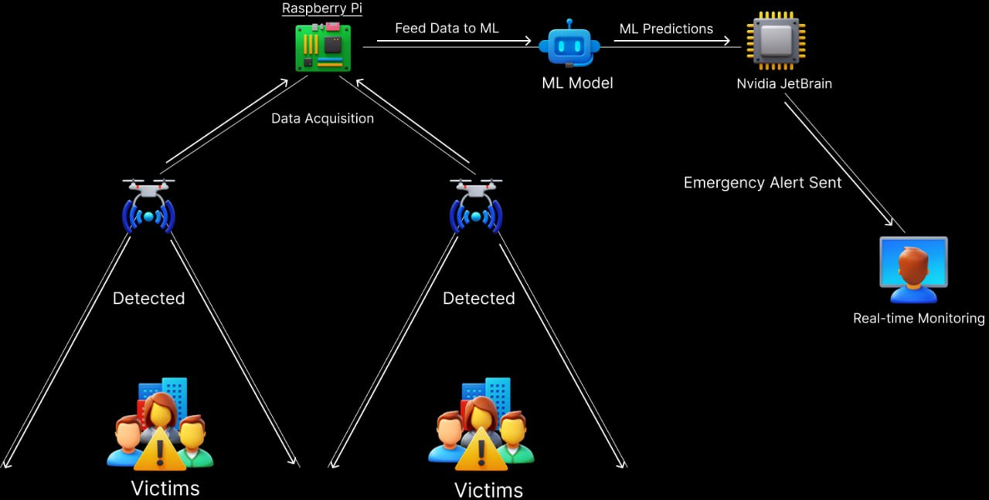
TECHNICAL APPROACH
System Model
Technologies used
AI Models: YOLOv8 (Visual Spotter) & Random Forest (Physics Verifier)
Data Processing: Python, OpenCV, Pandas (Image & sensor data manipulation)
Backend & UI: Flask, HTML/CSS (Lightweight edge web server)
Sensors: RGB Camera, ToF (Depth), Thermal (Multi-modal data collection)
Deploy: Ngrok

Slide 5
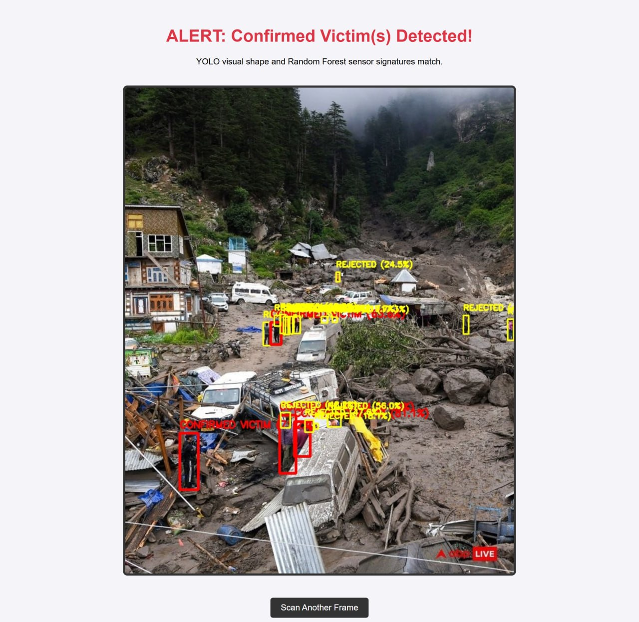

RESULTS
User Interface
Victim Detection

Slide 6
FEASIBILITY AND VIABILITY
1. Feasibility (Highly Viable)
Accessible Hardware: RGB, ToF, and Thermal sensors are affordable and lightweight.
Edge-Ready: YOLOv8 and Random Forest run efficiently on local, low-power devices.
2. Potential Risks
Alignment: Mismatched field-of-view between the camera and sensor grid.
Hardware Lag: Running deep learning on battery-powered drones/rovers.
Visual Blindness: Camera failure in extreme smoke or total darkness.
3. Mitigation Strategies
Calibration: Mathematically map camera pixels to the sensor grid before deployment.
Optimization: Compress to smaller models (e.g., YOLOv8 Nano) for real-time speed.
Fallback Logic: Allow ToF and Thermal to trigger alerts independently if the camera goes blind.

Slide 7
IMPACT AND BENEFITS
1. Impact on Target Audience (Rescue Teams)
Unmatched Safety: Keeps first responders out of unstable, hazardous zones by eliminating false alarms.
Rapid Precision: Drastically reduces search time, allowing teams to focus strictly on verified human targets.
Reduced Fatigue: Prevents the physical and mental exhaustion of chasing "ghost" targets or debris.
2. Broad Benefits (Social, Economic, Environmental)
Social (Life-Saving): Maximizes victim survival rates by speeding up discovery during the critical "golden hour" of a disaster.
Economic (Cost-Efficient): Saves massive operational rescue costs (helicopter fuel, equipment wear, and man-hours) wasted on false positives.
Environmental (Low Footprint): Reduces unnecessary drone/rover deployments and minimizes further disruption to fragile, collapsed environments.

Slide 8
RESEARCH AND REFERENCES
Jocher, G., Chaurasia, A., & Qiu, J. (2023). YOLO by Ultralytics (Version 8.0). Open-source repository.
Redmon, J., et al. (2016). "You Only Look Once: Unified, Real-Time Object Detection." IEEE Conference on Computer Vision and Pattern Recognition (CVPR).
Breiman, L. (2001). "Random Forests." Machine Learning, 45(1), 5-32.
IEEE Transactions on Robotics: "Multispectral RGB-Thermal Sensor Fusion for Pedestrian Detection in Low-Visibility Conditions."
Journal of Field Robotics: "UAV/UGV Deployment in GPS-Denied Environments using 3D Depth Mapping and Time-of-Flight (ToF) Sensors."

